Slide 1
Student Study Management System Developed in PHP & MySQL

Slide 2
Abstract
“Student Study Center Management System” contains data and information of student who want to study in study center. The main purpose of SSCM is to systematically record, store and update the details of admin/student and also manage the desk to students. It is a user friendly system which is used by any study center easily.
“Student Study Center Management System” can lead to error free, secure, reliable and fast management system. It assists the user to concentrate on their other activities rather concentrate on the record keeping. Thus it will help study centers in better utilization of resources. The study centers can maintain computerized records without redundant entries. That means that one need not be distracted by information that not relevant, while being able to reach the information.
The aim to automate its existing manual system by the help of computerized equipment's and full-fledge computer software, fulfilling their requirements, so that their valuable data/information can be stored for a long period with easy accessing and manipulation of the same. Basically the project describes how to manage for good performance and better services for the study centers.

Slide 3
Purpose of the Project
In the Previous System, Details are Stored Manually in papers, to share the details between study centers was a financial drawback. Updations in the details is a tedious task. But a new system was proposed to overcome the above drawbacks.
Functionalities and advantages of proposed system are:
Data is Centralized which has overcome the Sharing problem in previous system.
As data is Maintained electronically, it’s easy for a person to update the details, which has overcome the tedious updation in previous system.
Maintenance is easy and performance is good.

Slide 4
Scope of the Project
“Student Study Center Management System” contains data and information of student who want to study in study center. The main purpose of SSCM is to systematically record, store and update the details of admin/student and also manage the desk to students. It is a user friendly system which is used by any study center easily.
The aim to automate its existing manual system by the help of computerized equipments and full-fledge computer software, fulfilling their requirements, so that their valuable data/information can be stored for a long period with easy accessing and manipulation of the same. Basically the project describes how to manage for good performance and better services for the study centers.

Slide 5
Project Modules
“Student Study Center Management System” contains data and information of student who want to study in study center. The main purpose of SSCM is to systematically record, store and update the details of admin/student and also manage the desk to students.
In “Student Study Center Management System” we use PHP and MySQL database. This is the project which keeps records of admin/student and also manage the desk to students.
In SSCMS project we use PHP and MySQL database. It has One module.

Slide 6
Admin Module
Dashboard: In this section, admin can view the total, available, and occupied Desks. Admin can also view the total registered users.
Desks: In this section, admin can manage the desks (add, update, delete).
Students: In this section, admin can manage the students (add, update, delete, view details).
Assigned/Un-Assigned Desk: In this section, admin can assign and un-assign the desk to the students.
Report: In this section, admin can generate the b/w dates report of assigned desks.
Admin can also update his profile, change password and recover password.

Slide 7
Requirement Specification
Hardware Configuration:
Client Side
Server Side
RAM | 512 MB
Hard Disk | 10GB
Processor | 1.0 GHz
RAM | 1 GB
Hard Disk | 20GB
Processor | 2.0GHz

Slide 8
Continue.....
Software Requirement:
Client Side
Server Side
Web Browser | Google Chrome or any compatible browser
Operating System | Windows or any equivalent OS
Web Server | APACHE
Server side Language | PHP5.6 or above version
Database Server | MySQL
Web Browser | Google Chrome or any compatible browser
Operating System | Windows or any equivalent OS

Slide 9
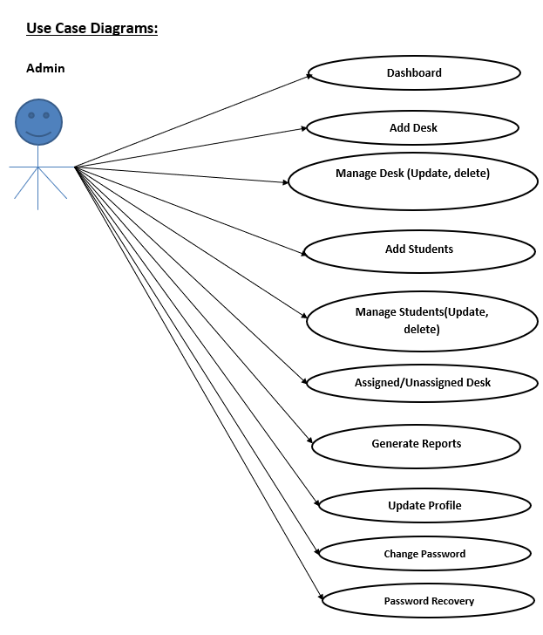
Use Case Diagram
Notes:
USECASE DIAGRAM: A Use case is a description of set of sequence of actions. Graphically it is rendered as an ellipse with solid line including only its name. Use case diagram is a behavioral diagram that shows a set of use cases and actors and their relationship. It is an association between the use cases and actors. An actor represents a real-world object. Primary Actor – Sender, Secondary Actor Receiver.

Slide 10
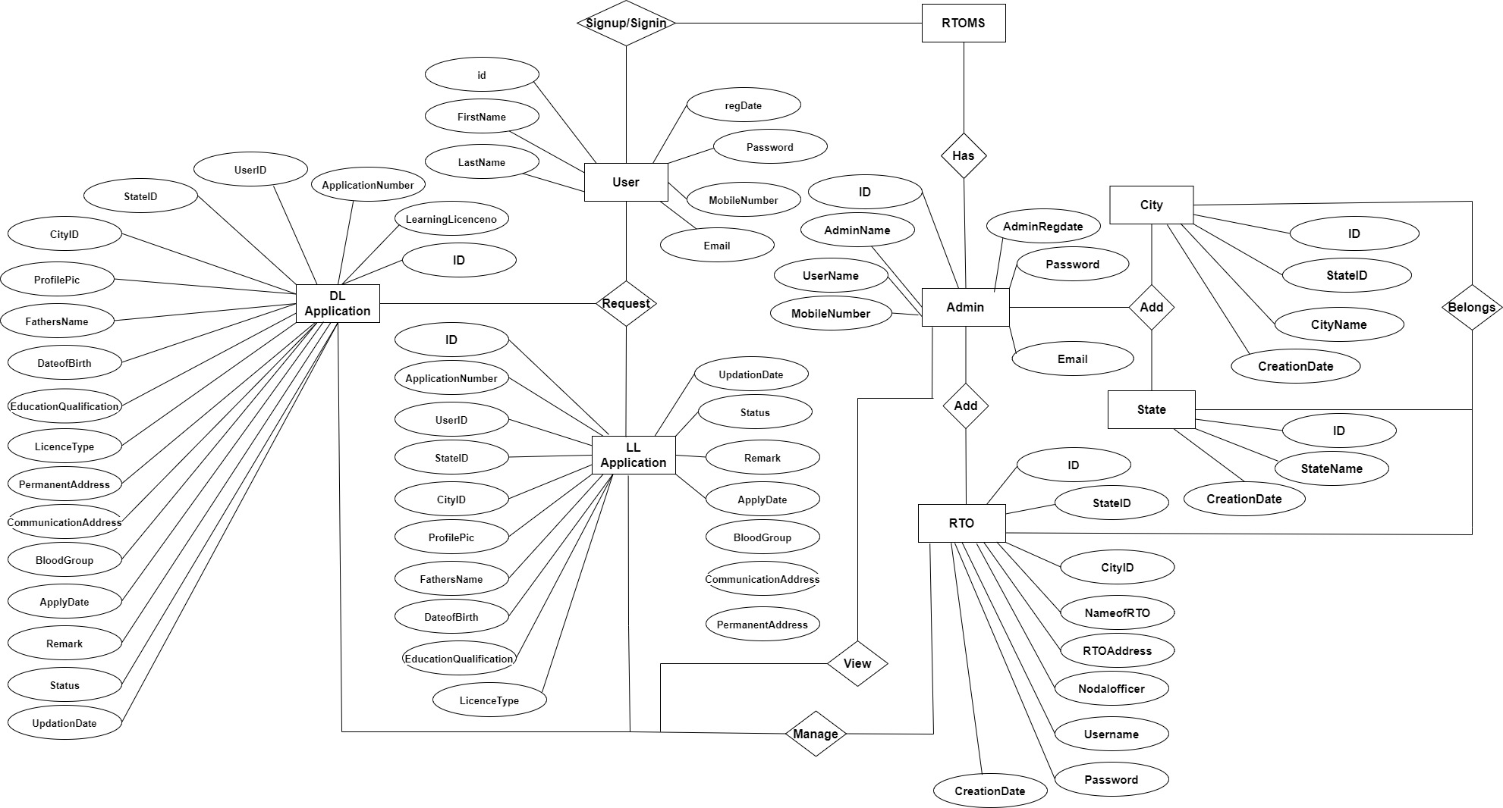
ER Diagram

Slide 11
Dataflow Diagrams (DFDs)
A Data Flow Diagram (DFD) is a traditional visual representation of the information flows within a system. A neat and clear DFD can depict the right amount of the system requirement graphically. It can be manual, automated, or a combination of both.
It shows how data enters and leaves the system, what changes the information, and where data is stored.
The objective of a DFD is to show the scope and boundaries of a system as a whole. It may be used as a communication tool between a system analyst and any person who plays a part in the order that acts as a starting point for redesigning a system. The DFD is also called as a data flow graph or bubble chart.

Slide 12
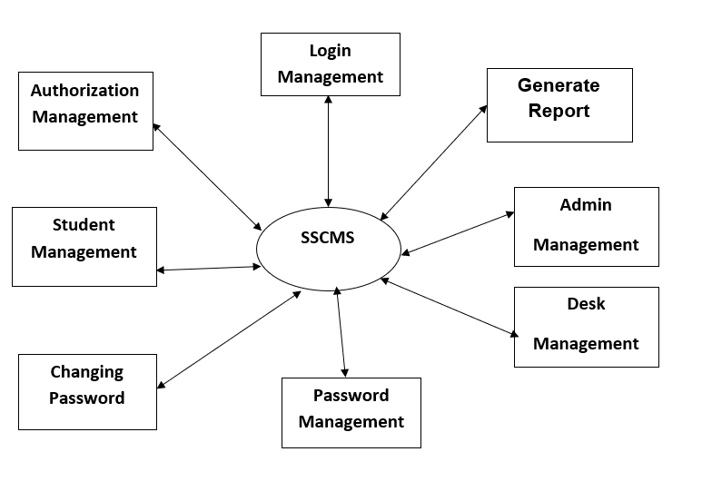
Zero level

Slide 13
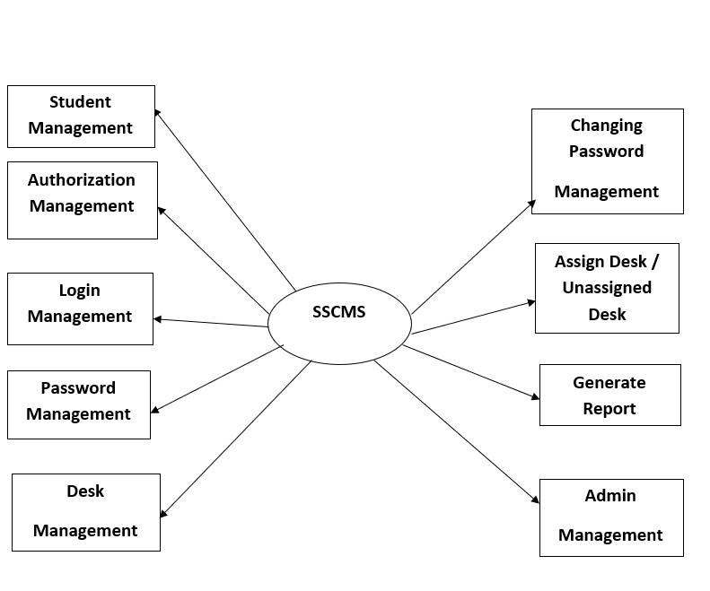
First level

Slide 14
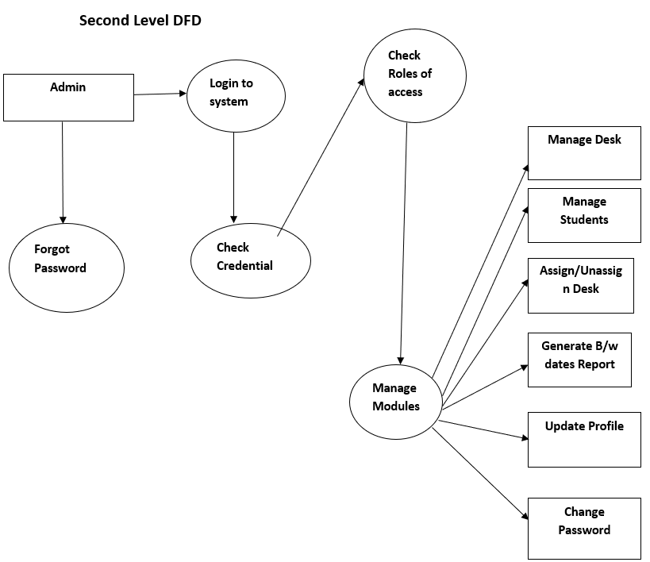

Slide 15
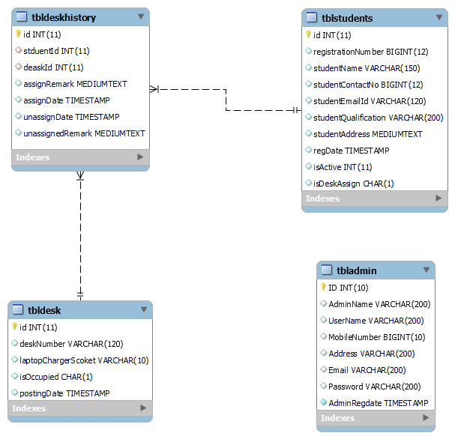
Class Diagram
Notes:
The class diagram shows a set of classes, interfaces, collaborations and their relationships.

Slide 16
Implementation and System Testing
After all phase have been perfectly done, the system will be implemented to the server and the system can be used.
System Testing
The goal of the system testing process was to determine all faults in our project .The program was subjected to a set of test inputs and many explanations were made and based on these explanations it will be decided whether the program behaves as expected or not. Our Project went through two levels of testing
Unit testing
Integration testing

Slide 17
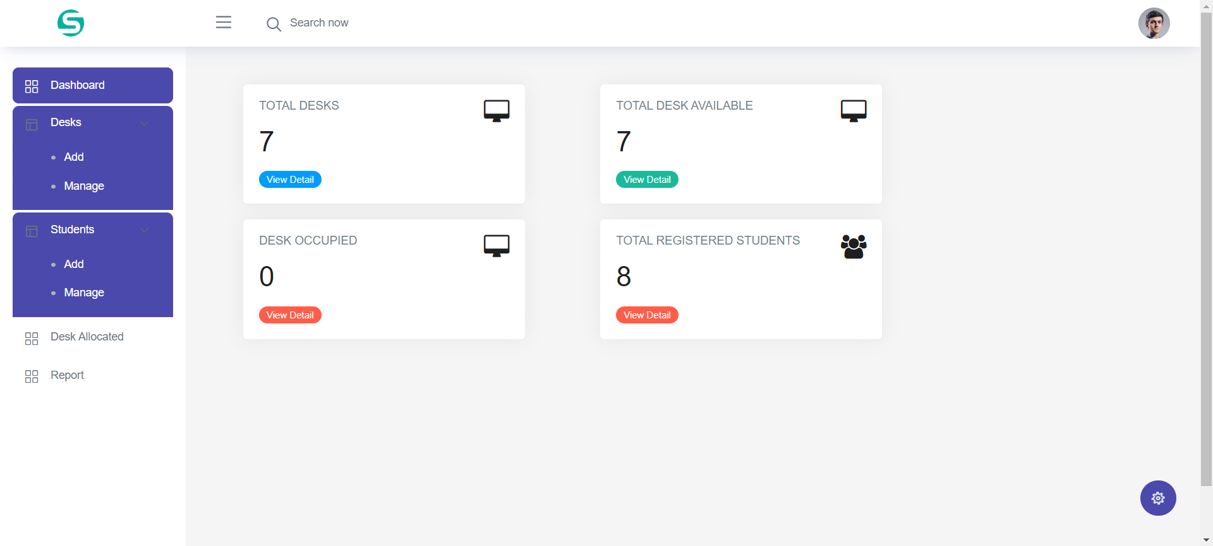
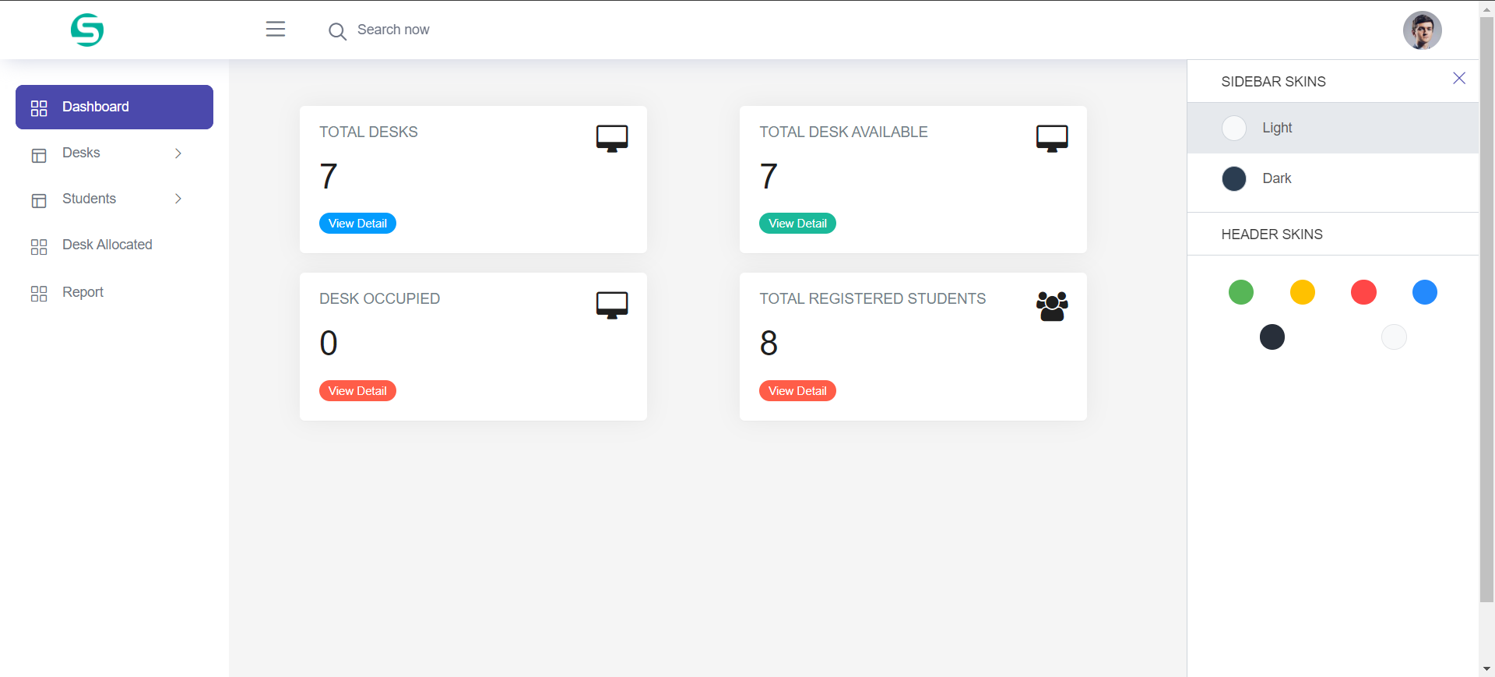
Project Screens

Slide 18
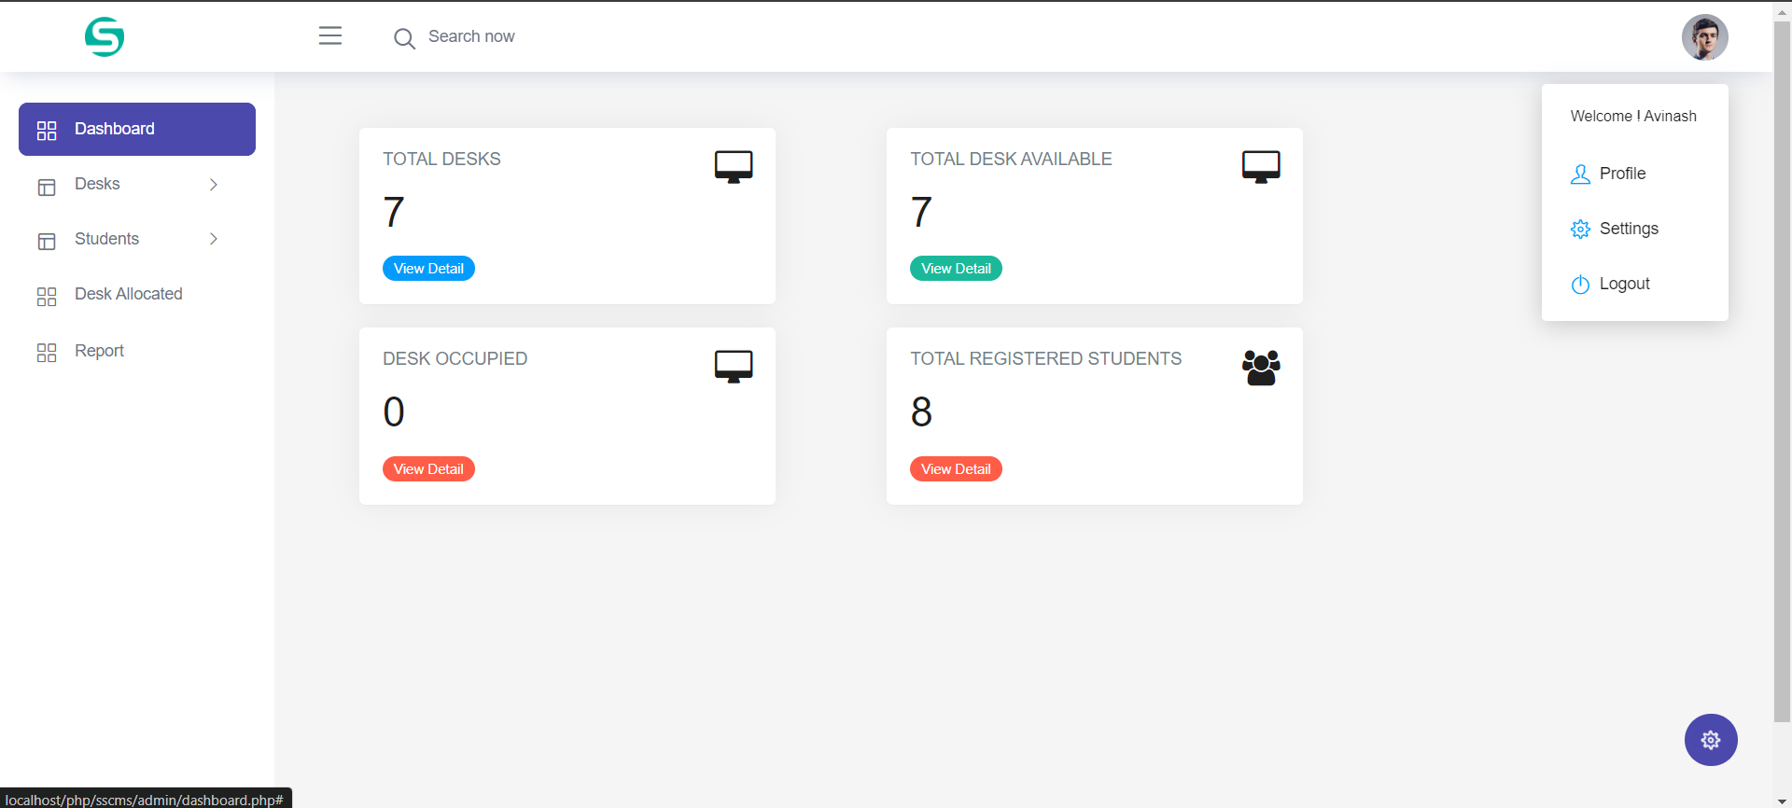
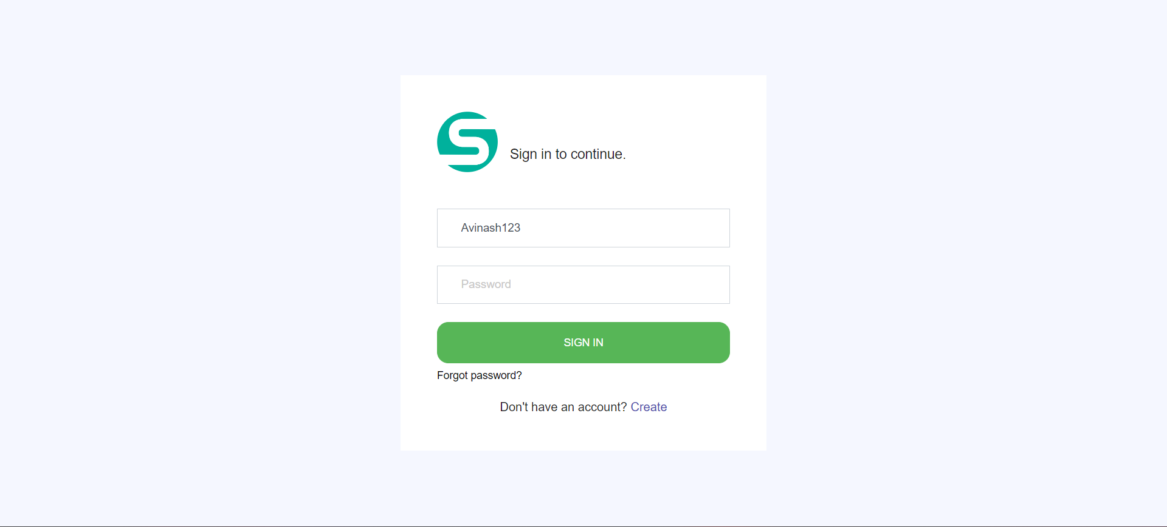

Slide 19
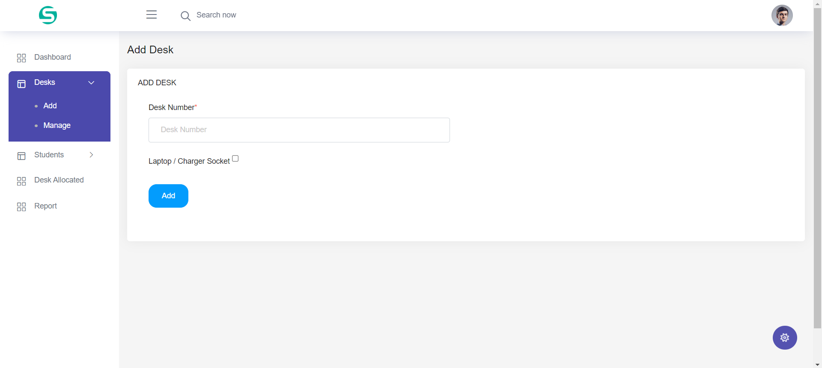
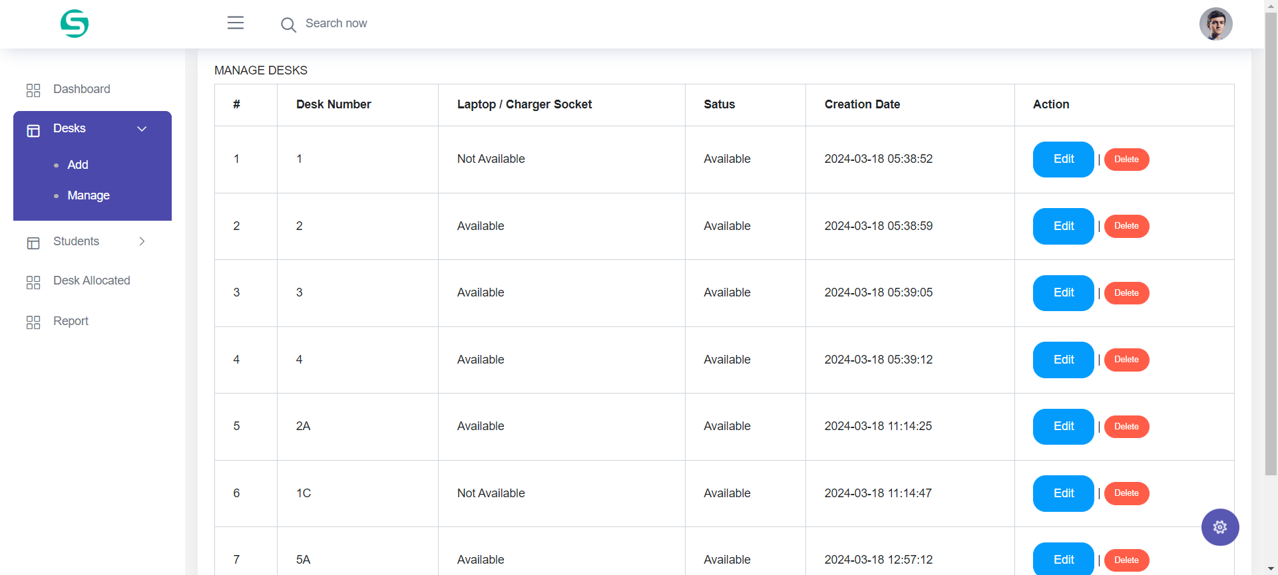

Slide 20
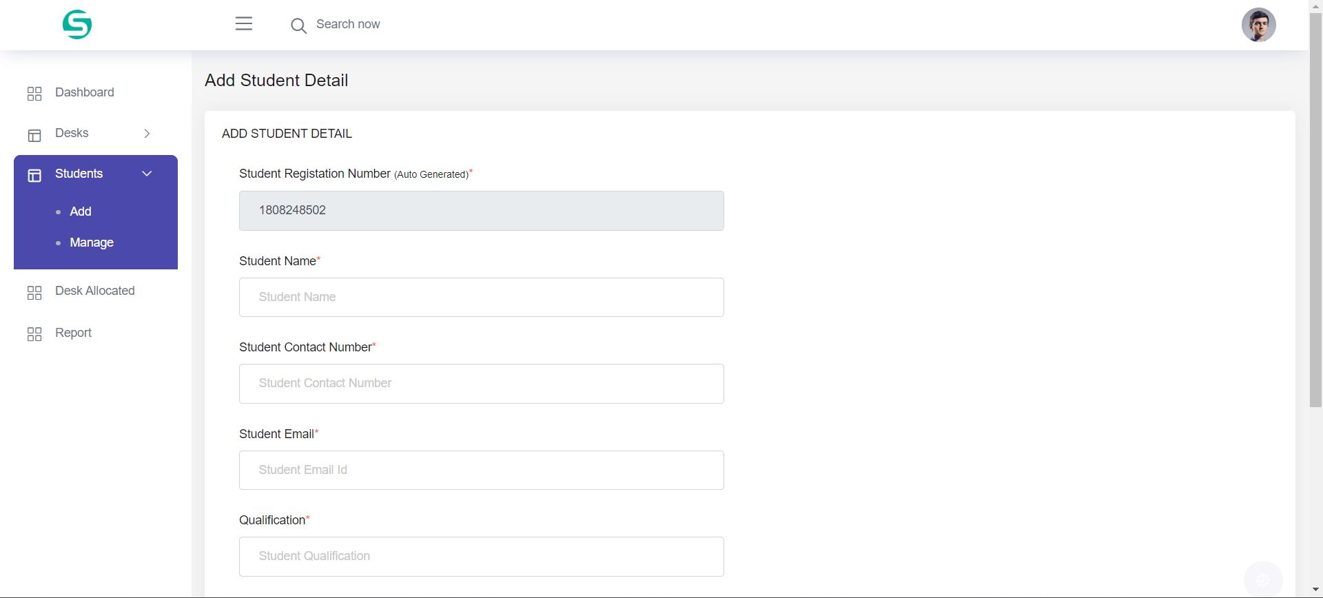
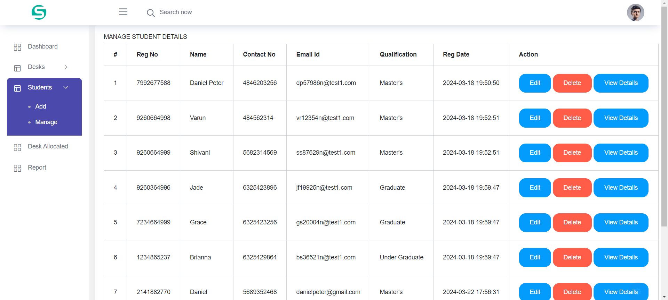

Slide 21
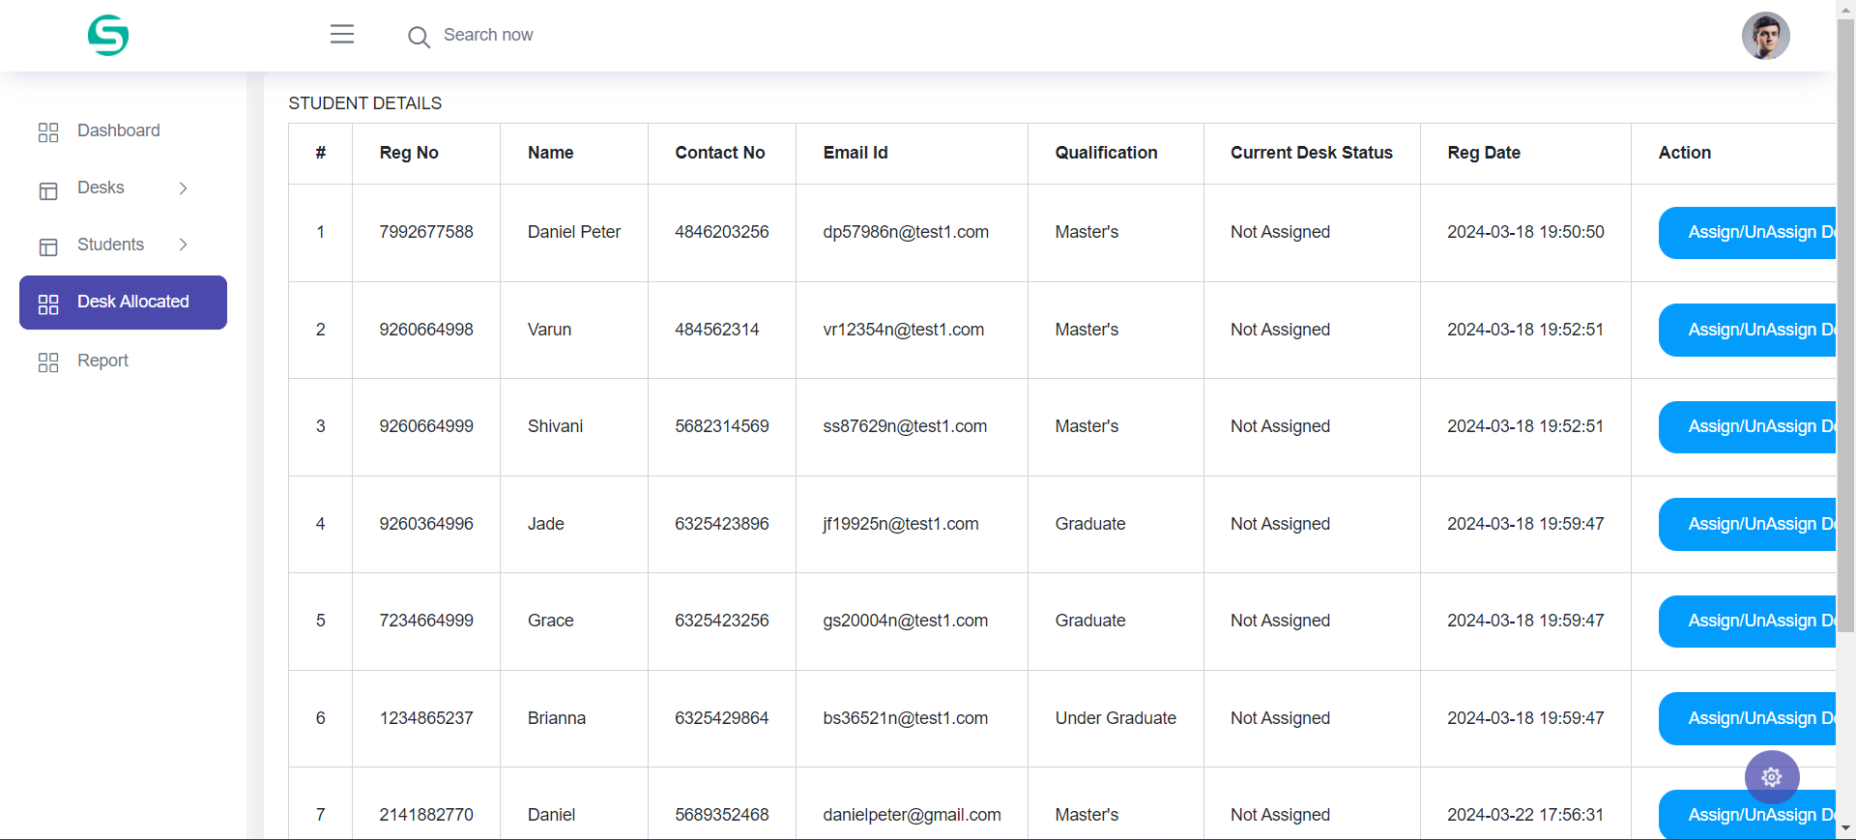
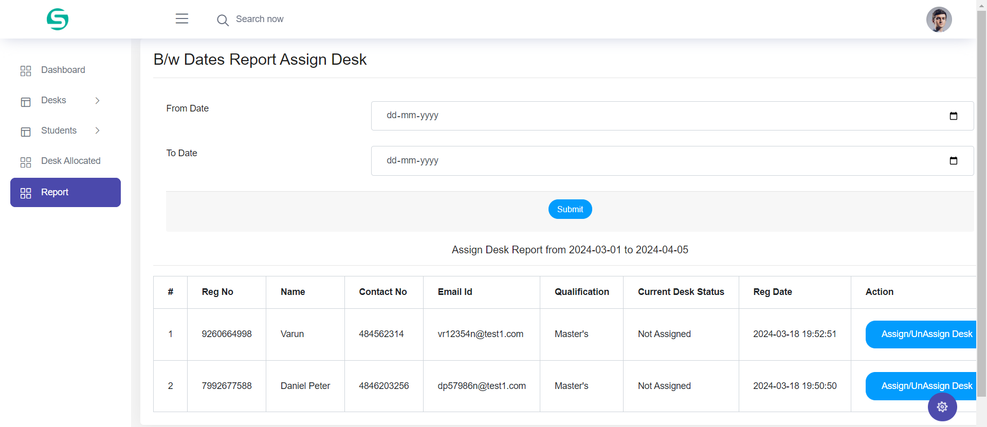

Slide 22
Conclusion
This Application provides an online version of Student Study Center Management System which will benefit the study centers who want to maintain records of student’s details and assigned desk to student without wasting a time and apply with their convenience.
It makes entire process online and can generate reports.
The Application was designed in such a way that future changes can be done easily. The following conclusions can be deduced from the development of the project.
Automation of the entire system improves the productivity.
It provides a friendly graphical user interface which proves to be better when compared to the existing system.
It gives appropriate access to the authorized users depending on their permissions.
It effectively overcomes the delay in communications.
Updating of information becomes so easier.
System security, data security and reliability are the striking features.
The System has adequate scope for modification in future if it is necessary.

Slide 23
References
www.w3schools.com
php.net
en.wikipedia.org/wiki/PHP
www.hotscripts.com/category/php/
www.apache.org
www.mysql.com/click.php?e=35050

Slide 24
Thank You

